Slide 1
CSYE 7220 DevOps
Microservices on Kubernetes
Presented By:
Sapna Patel (001023371)
Shivam Thakkar (001023257)

Slide 2
Goal
We are running sentimental-Analysis microservice on kubernetes cluster. Our applications are running on aws and Azure platform. Four applications React, Python, Java and Dotnet application. This application perform sentiment Analysis on song.
We performed CI/CD pipeline , load balancing and Monitoring of our application..

Slide 3
Tools
Azure
AWS
Terraform
Kubernetes
Docker/DockerHUB
CircleCI (CI/CD)
Prometheus
JMeter
Apache Bench(AB)
Alert Manager

Slide 4
Infrastructure AS Code
Build infrastructure Using Terraform on AWS and Azure
All the resources required along with kubernetes cluster

Slide 5
CI/CD
For every new commit It triggered the CI/CD pipeline in CircleCI.
CircleCI build new Docker image for new changes and Push Docker image to DockerHuB
In pipeline i configured kubectl and config-map to deploy application on AWS.
When all docker image are build and push to the pipeline deploy application and service to K8S cluster

Slide 6
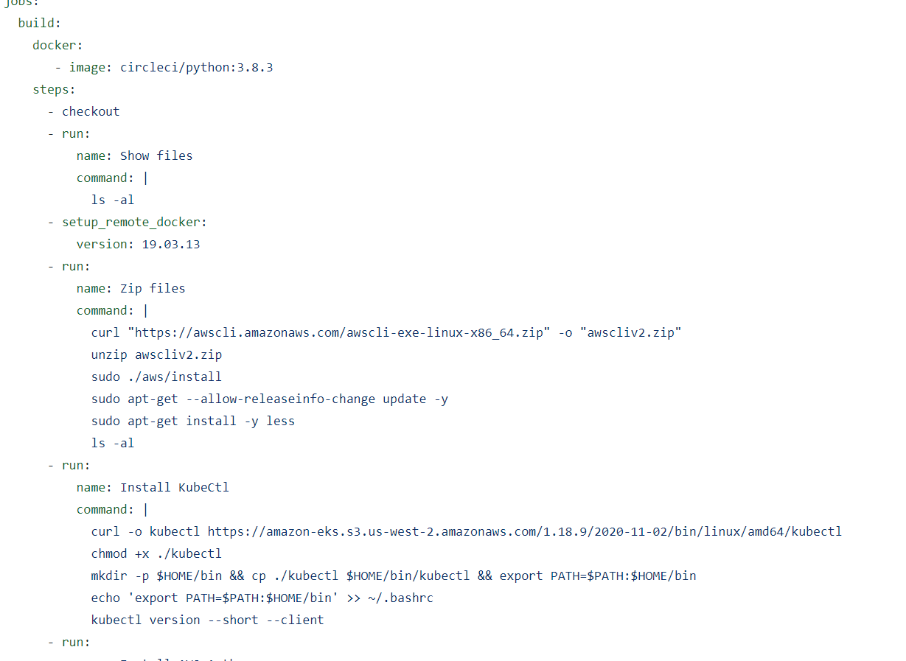
CircleCI

Slide 7
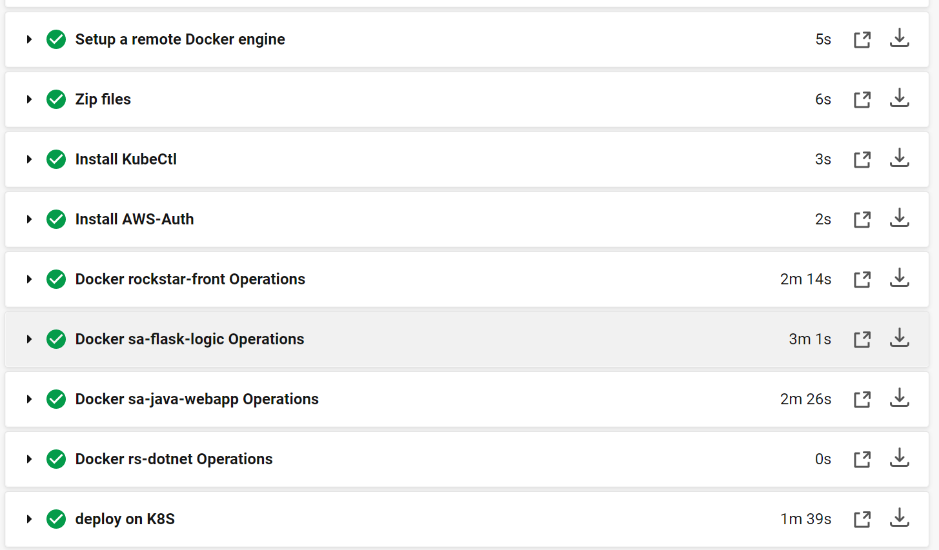
CircleCI Screenshot

Slide 8
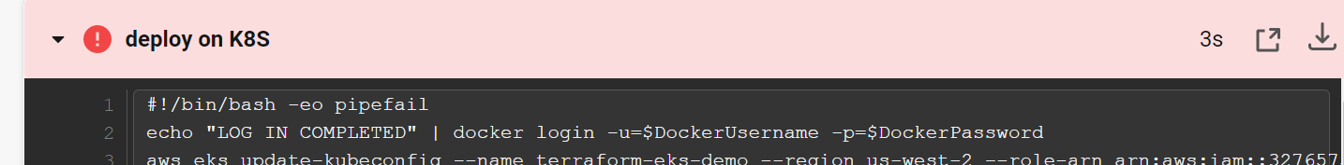
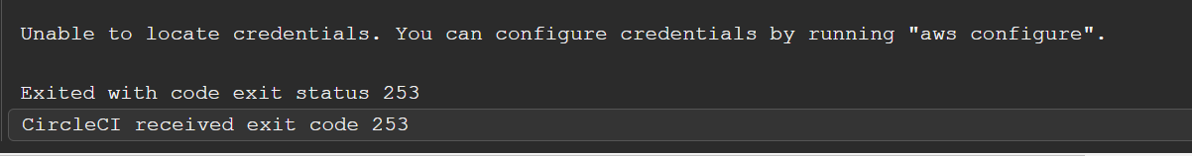
Some failure running in CI/CD

Slide 9
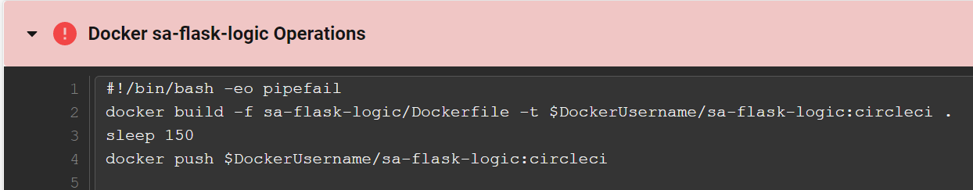
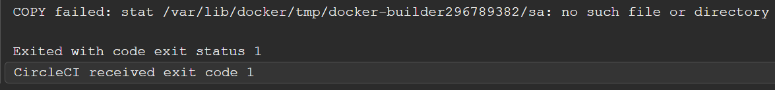

Slide 10

AWS

Slide 11
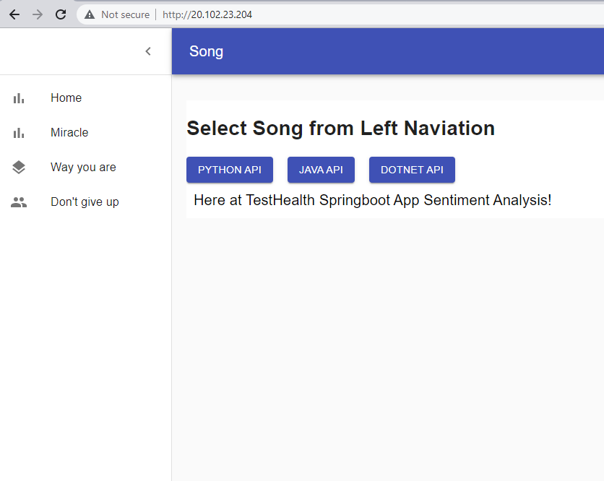
Azure

Slide 12
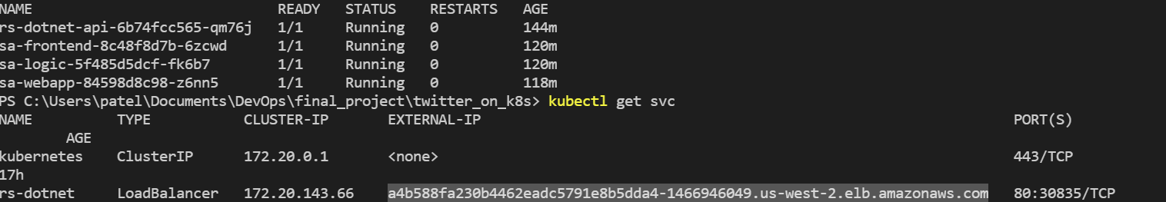
Configured Kubectl
Configured kubectl locally to see running pods and services

Slide 13
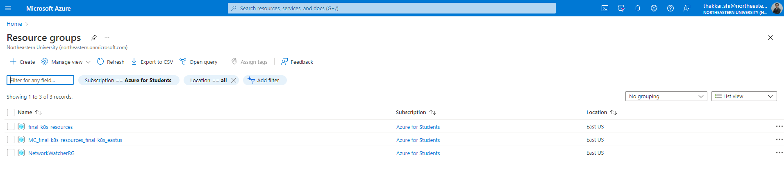
AKS Deployment and Autoscaling
For initial setup with AKS ran terraform commands and after terraform apply we got 2 resources created
With Azure service principal credentials and keep prefix final

Slide 14
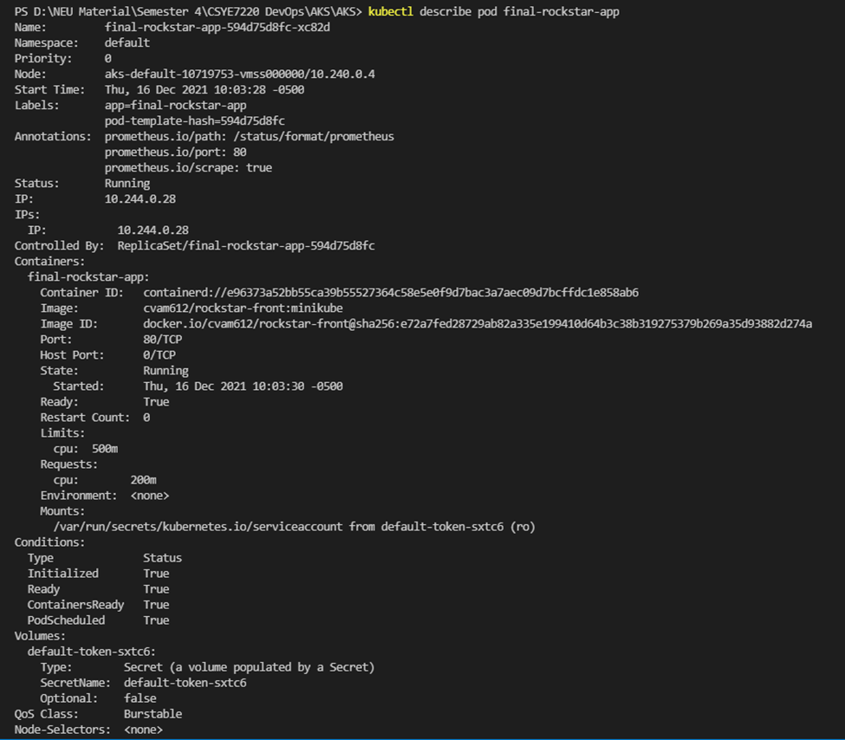
Configuration with kubectl
For verification of cluster information we have checked kubectl describe pod <pod_name>

Slide 15

Configuration with kube_config
Run commands to create config file and remove the extra notation from the output file and then copy the file to config file
terraform output kube_config > C:\Users\cvam6\.kube\config-terraform-aks-demo

Slide 16
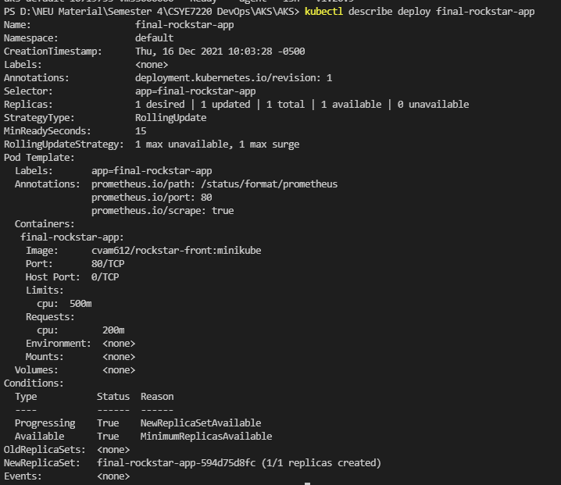
Horizontal autoscaling

Slide 17
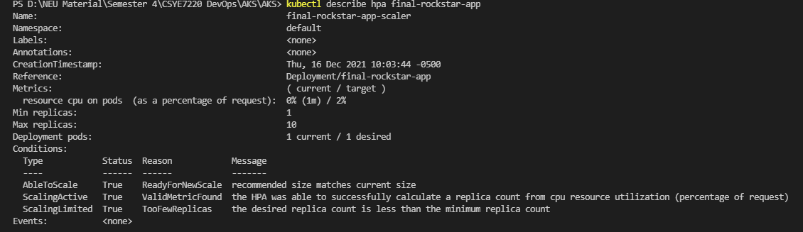
Horizontal pods autoscaling

Slide 18


Prometheus Monitoring
Prometheus server deployment with namespace monitoring
After deployment of prometheus server,

Slide 19
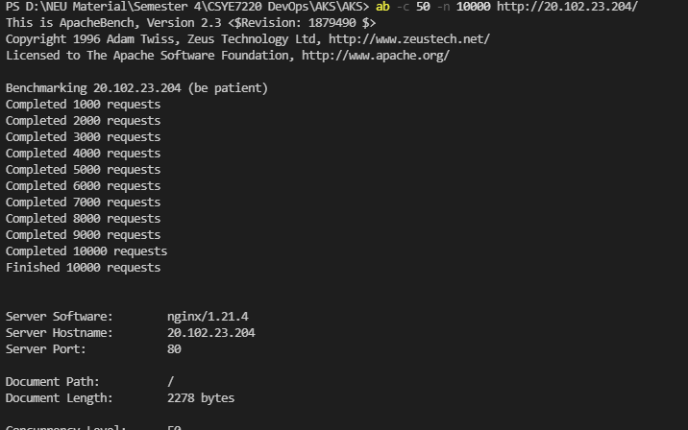
Load testing with Apache bench
Try to perform load test with Apache Bench

Slide 20
Load testing with Apache bench
Results for the pods auto scaling with Apache Bench
Auto scaled to more than one replicas after threshold value of 2%

Slide 21
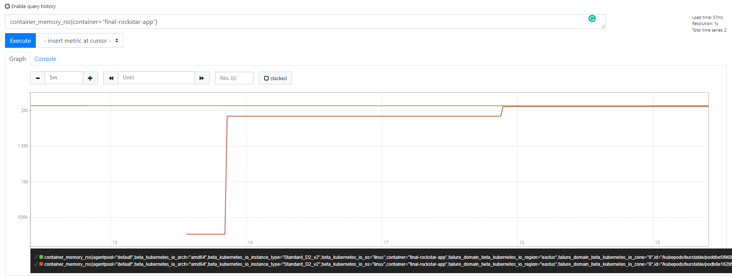
Load testing with Apache bench
Prometheus chart for the pods are as below

Slide 22
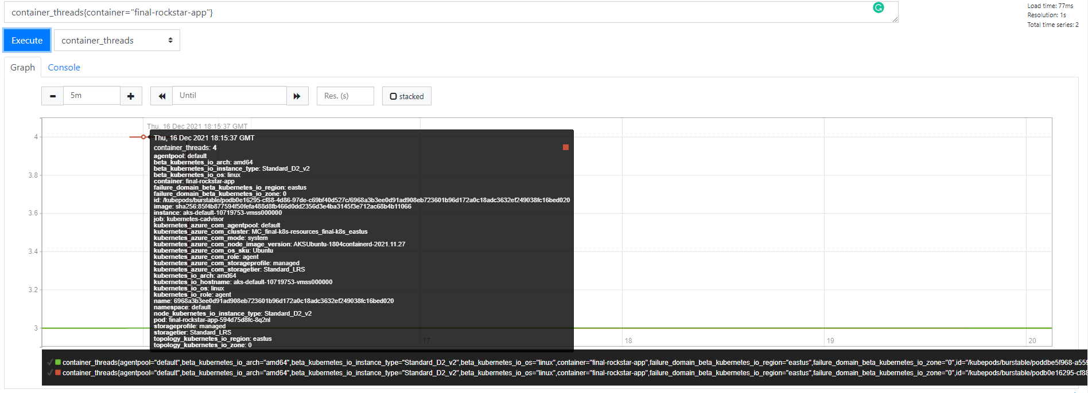
Load testing with Apache bench
Prometheus chart for the pods are as below

Slide 23
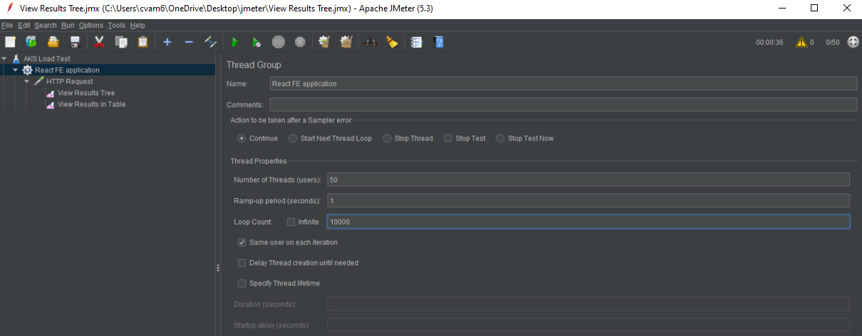
Load testing with Jmeter
Configured Jmeter with the http gateway and 50 threads per loop and put the 10000 loops same as the Apache Bench

Slide 24
Load testing with Jmeter
Got the CPU usage more than 50% so the replicas auto created to max limit and then after stop the process, it again went down to minimum pod limit 1
Created replicas as the threshold increases

Slide 25
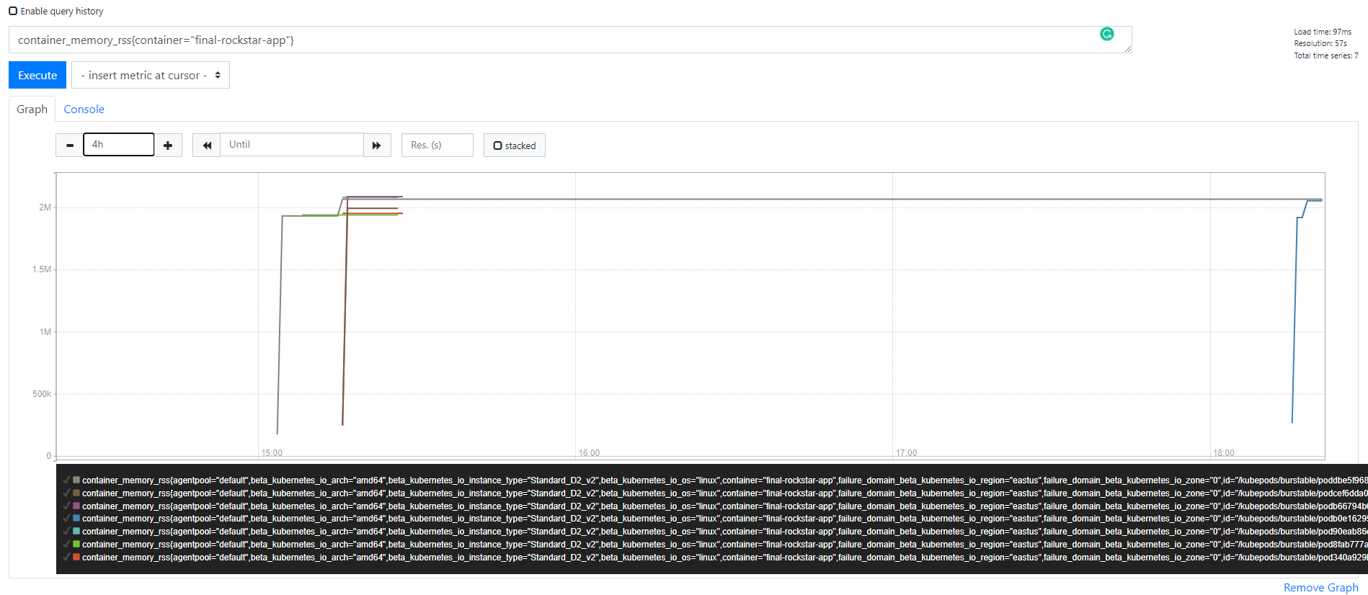
Load testing with Jmeter
Prometheus graph for Jmeter generated load

Slide 26
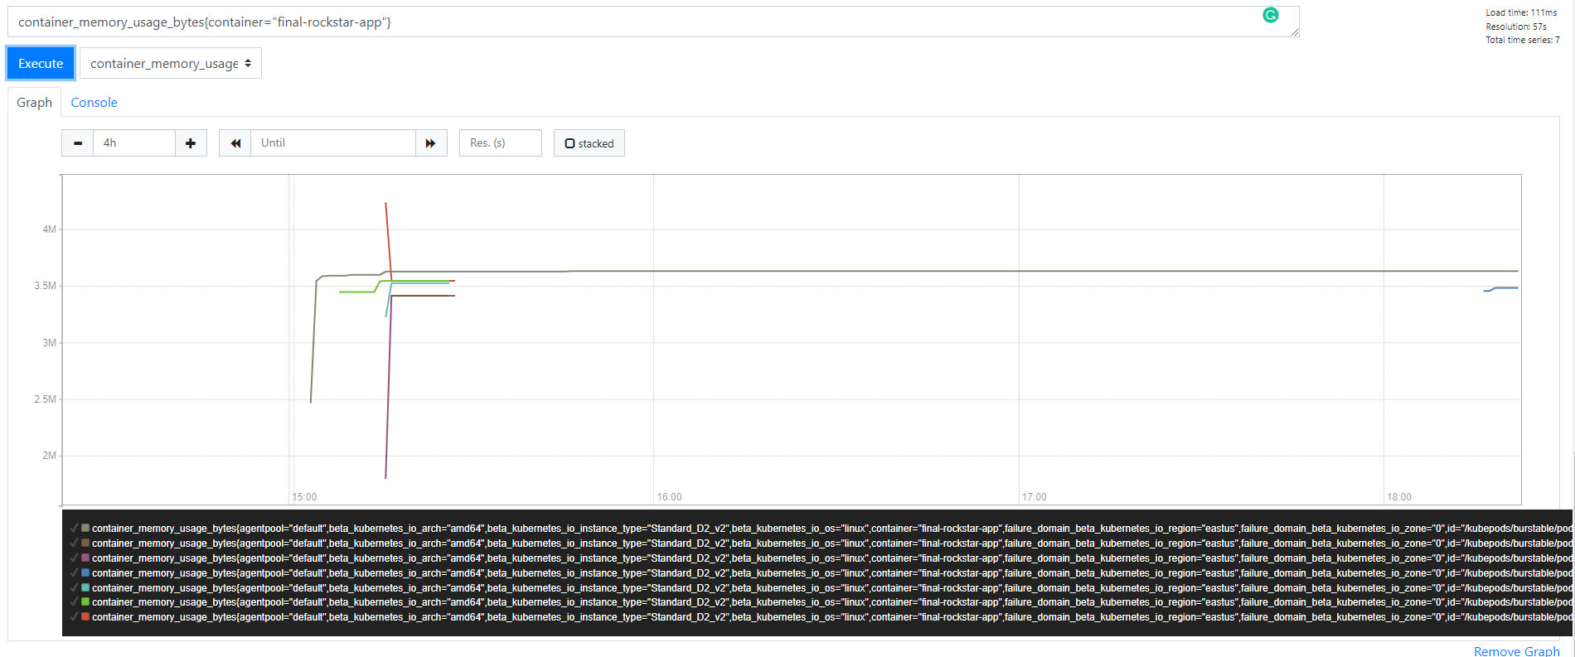
Load testing with Jmeter
Prometheus graph for Jmeter generated load

Slide 27
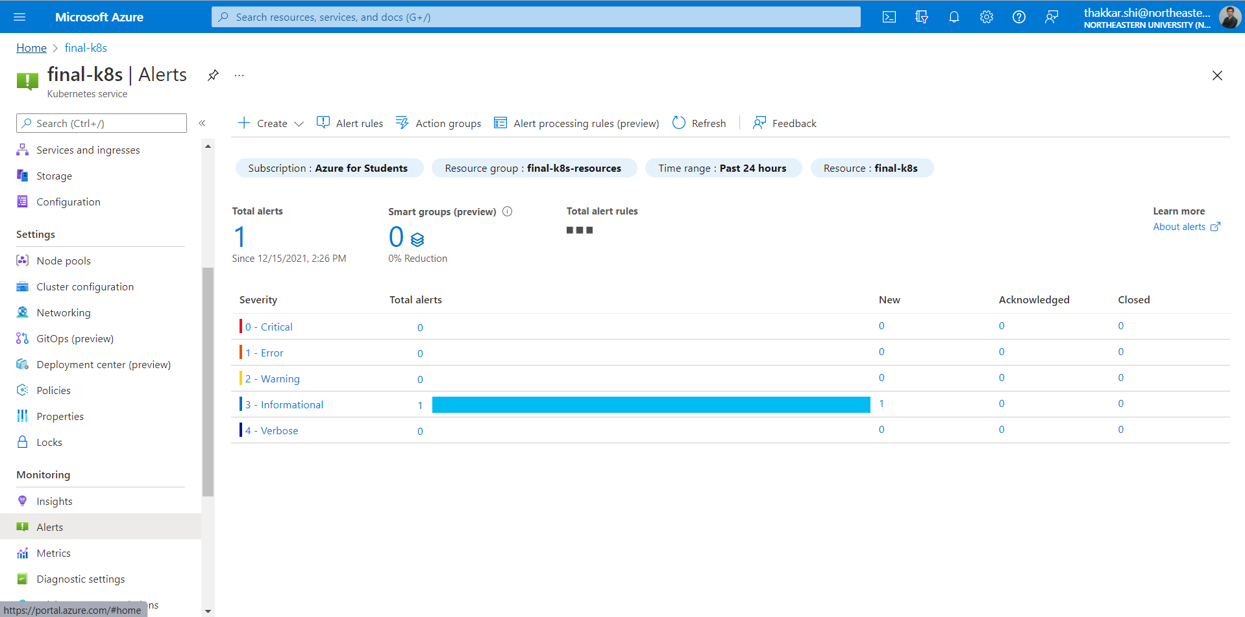
Alert with Azure Monitor

Slide 28
Thank you

